Slide 1



DigitalZoom™ Reporting
Notes:
Flow of the presentation:
World is changing (digital disruption)
There will be winners and losers
We want you to be a winner!
What challenges do you have
Identify their value driver
Identify their pain points
Reframe the conversation across the SDLC pipeline
What is required to achieve success
How Perfecto can help
Speaker notes:
Introduce yourself
Describe the outcome you’d like to achieve with the meeting
Gather their goals of the meeting

Slide 2
Agenda
Introducing DigitalZoom – Concepts & Overview
Main Sections
  Report Library
  HeatMap
  CI Dashboard
Increasing value from DigitalZoom
Notes:
Perfecto’s reporting application is much more than a list of executions. Designed to provide analysis information for testers, developers & managers & full integration with external tools, Digital Zoom provides multiple angles that combine to show a complete picture of the application’s performance across time, platforms, devices & versions.
We’ll look at the concepts of Digital zoom, its main components and then see how to use it best.

Slide 3
Digital Zoom Overview

Slide 4




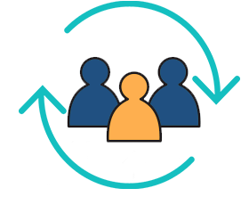
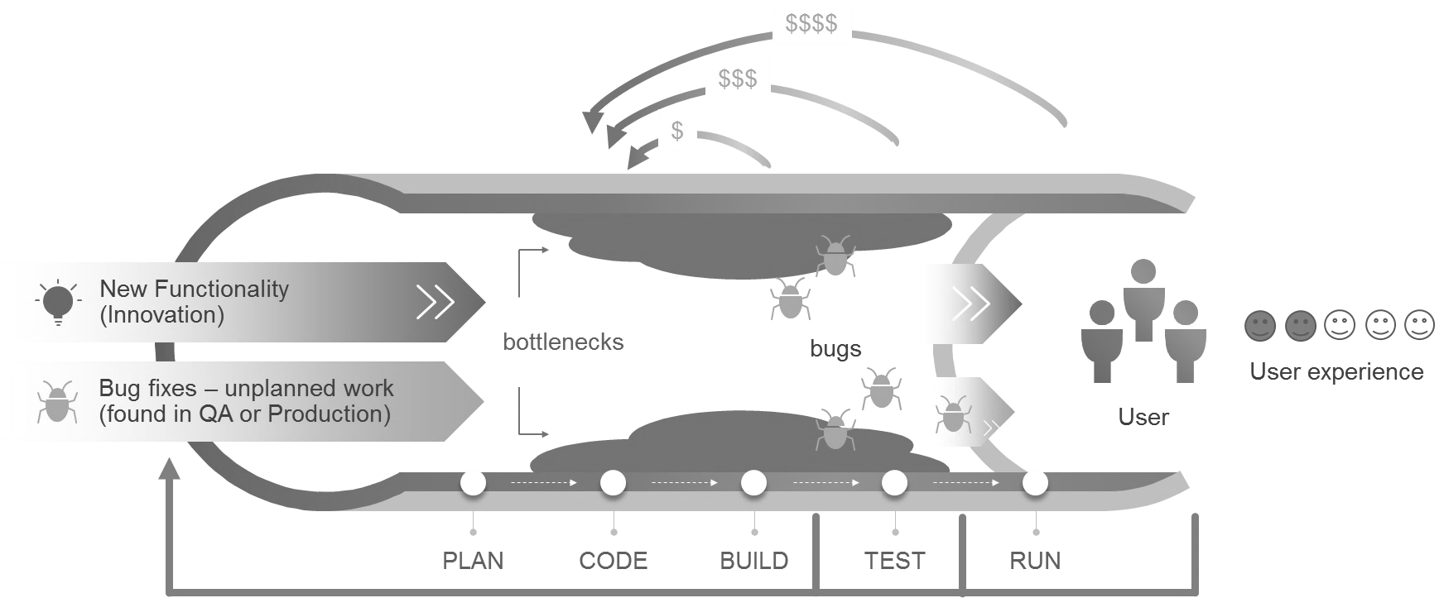
Digital Zoom™ - Using Reports Across The SDLC
Developer
Dev & Test Engineer
QA Manager/Executives
Agile/Feature Teams
Show me my build status
Point me to the exact breaking point
I’d like to get data using Jira, Jenkins and Slack
Help me optimize quality processes by building sustainable testing methodology
Maximize context during test authoring
Work within my IDE/FW
Have the quality visibility to support decisions during the SDLC
Understand where problems are in order to address the right people/teams
Understand trends and challenges over time
Cross feature team communication through Slack, Jira and custom reports
DevOps quality visibility per feature team and post integration phase
Notes:
Management dashboard – executives seek the ability at any given time to understand the product quality, the risk areas within the product. This in the context of digital is needed across all platforms. High level picture while emphasizing ‘risky’ areas.
Defect Triaging – ability to quickly resolve defects by having all available test data across platforms, regardless of the data size (hundreds, thousands of tests)
Slicing and dicing – practitioner “play ground”, ability to generate customized test reports based on tags, platforms, areas and more to assess test coverage, understand current quality risks and report to management. Dev would require this as part of his “area of responsibility” as well as fixing workflow

Slide 5
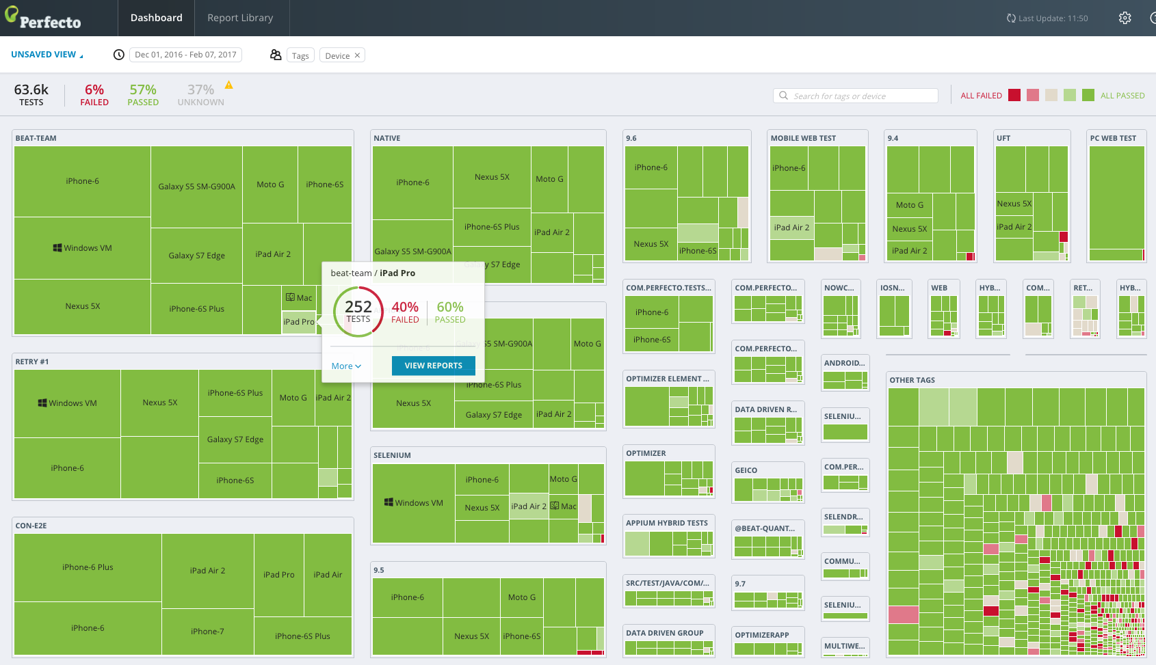
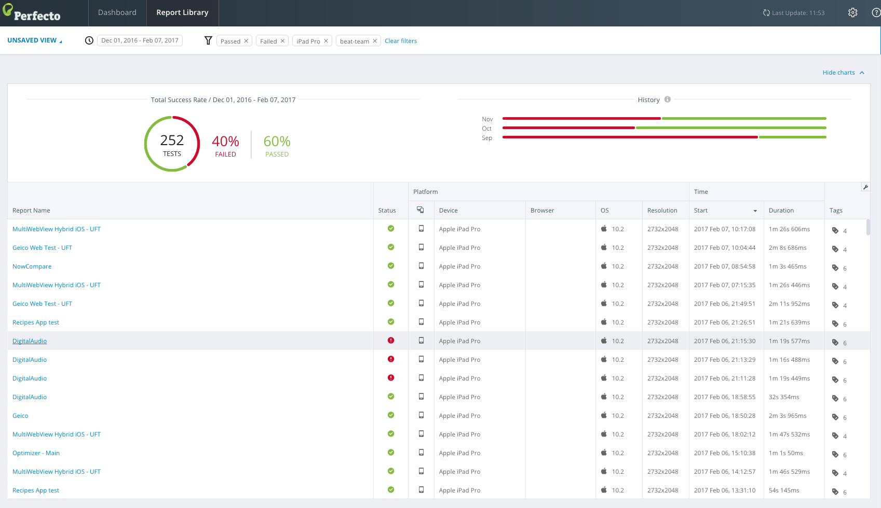
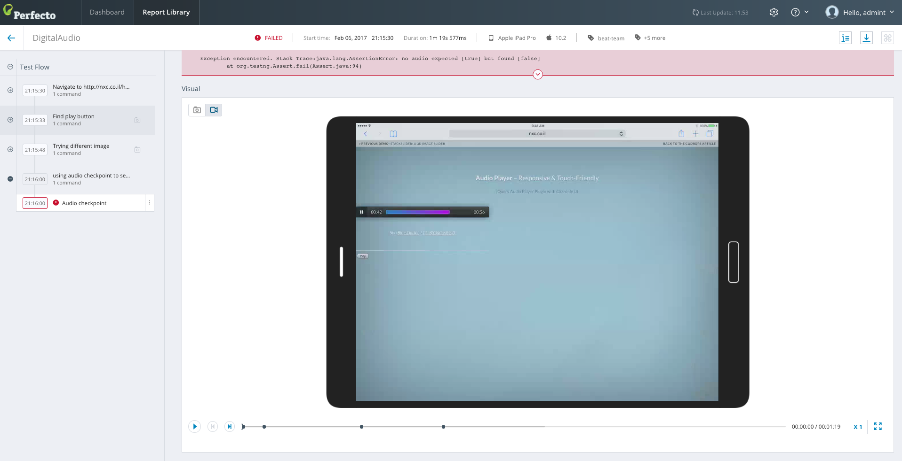
Drilling Down Capabilities
Quality dashboard in the digital era means:
  Cross platform visibility vs. single platform reports
  Customizable report with API’s vs. locked with off the shelf solutions
    Any dev language
    Any IDE
    Any test framework
  Data driven risk management based on digital platform data
3 layer reporting
  Single test report (STR)
  Suite level report (Grid)
  Complete Dashboard View (By category, By platform, By tags)
Notes:
One of the QA team’s challenges today (and quite a time consuming tasks for Dev to handle as well), is the test flakiness. No team that we’ve engaged with didn’t confirmed that they cannot get a consistent test execution repeatedly. In some cases, the test will pass on 1 platform while fail on the other, in other cases the test will get stuck due to environment issues, others will see issues around object locators. Be the reason be any of the above, the end-result of these flaky tests is greatly damaging TTM and efficiency.
Being able to get visibility into these flaky tests via dashboard, pre-planted tags and other filtering tools will allow teams to increase their test quality, their test coverage and more.
Once an issue is being identified – the Zoom-in is the easy part!

Slide 6
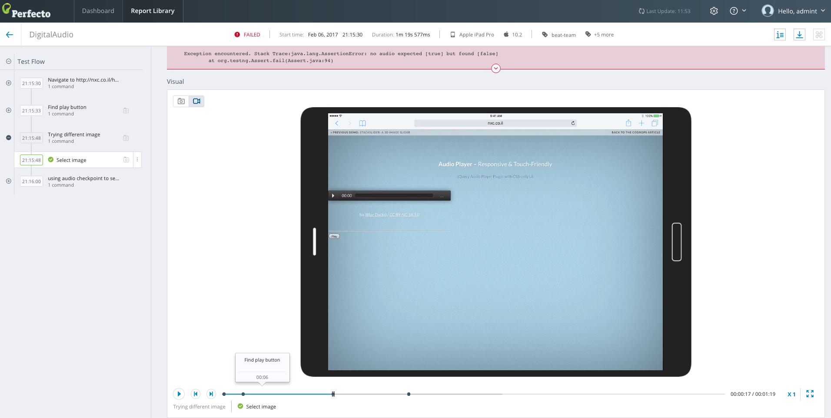
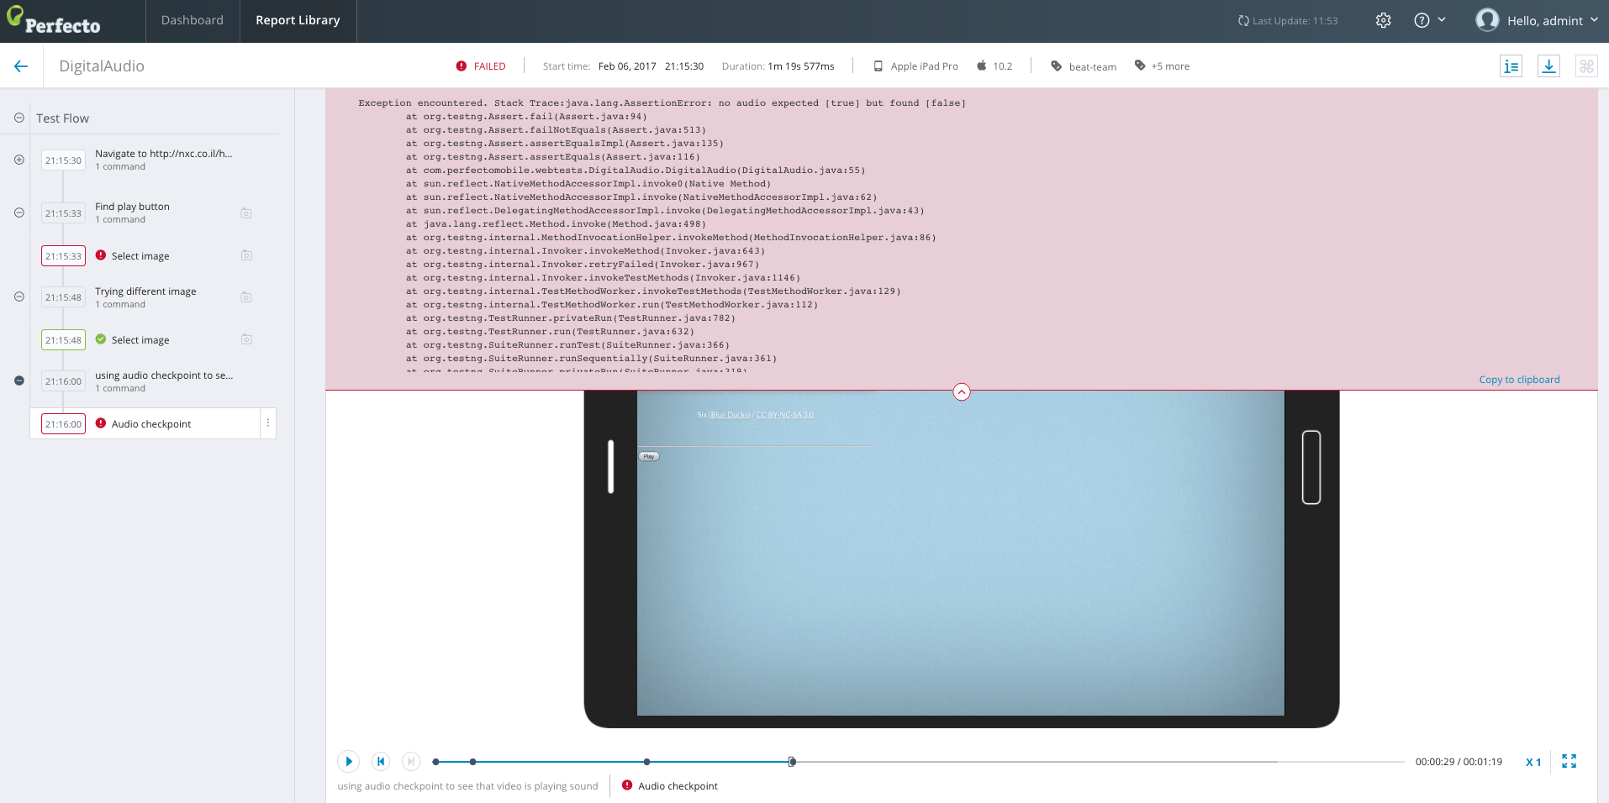
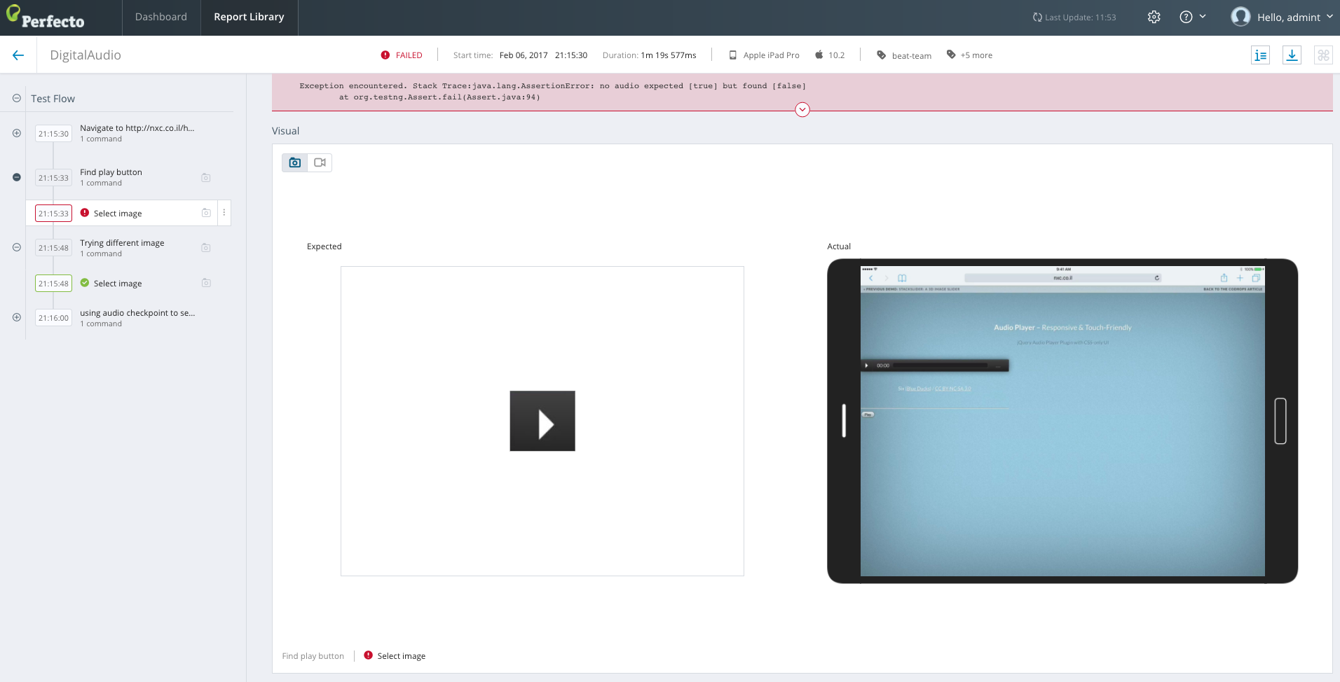
Defect Triaging – DigitalZoom™ Artifacts For RCA
Digital reporting artifacts supports fast MTTR
  Logs
  Videos
  Screenshots
  Stack Trace
  Vitals
  Network PCAP files
  PDF report
  Export report Using Public API (Json) for further processing
Video
Stack Trace
Screenshots (incl. expected vs. Actual)
Notes:
Perfecto’s DigitalZoom IS THE ONLY PLATFORM That maeks all artifacts accessible from one single spot .
You can also package everything and consume it as raw data using the Public API (JSON)

Slide 7
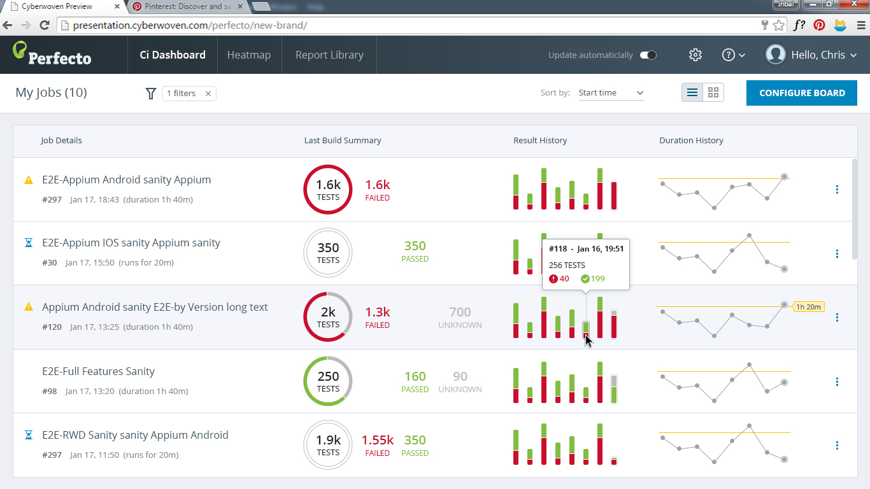
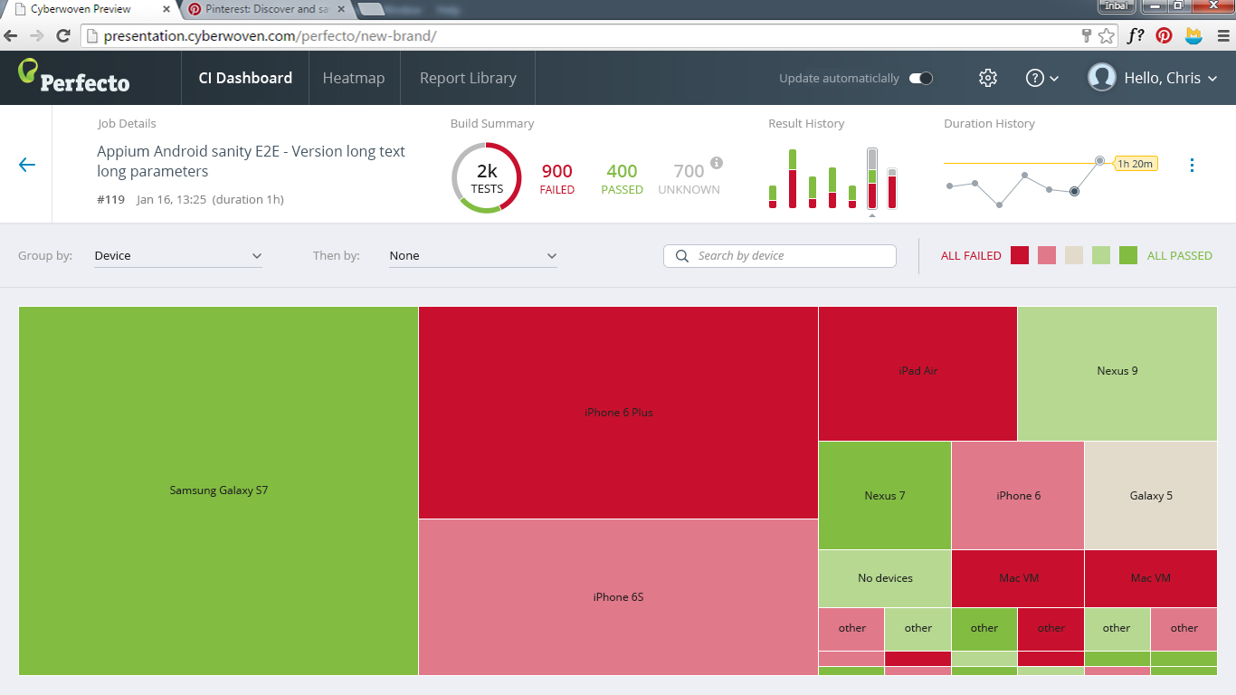
CI Dashboard Enables Build Trending And Overall Quality History Visibility

Slide 8


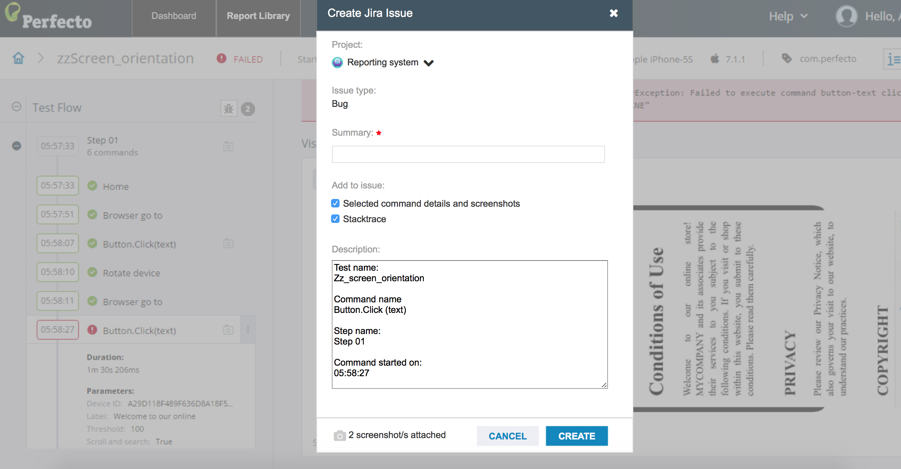
Communication & Alignment Empowers Quality Collaboration
Seamless Integrations

Slide 9
RTDD – Resolve defects Better and faster
On-Demand status reports
  By category
  By platform
  By tags
Better decision making around
  Product health, problematic areas
  Test suite effectiveness – what works, what doesn’t
  Test planning decisions – which tests to execute during which stage based on effectiveness
  Platform coverage and test coverage decisions
Risk management
  Go/NO Go decision making
Post execution test management
  Grouping tests by tags and filtering supports
Reporting Test Driven development
Author tests with future analysis in mind

Slide 10
Digital Zoom Components
Notes:
We are going to go from the bottom up. We’ll start by looking at a report for a single test, continue by looking at the report library which contains all the reports and review it’s customizing features & then look at 2 more views which help finding problems – the heatmap which shows health according to test & device & the CI Dashboard which shows progress per the dev cycle.

Slide 11
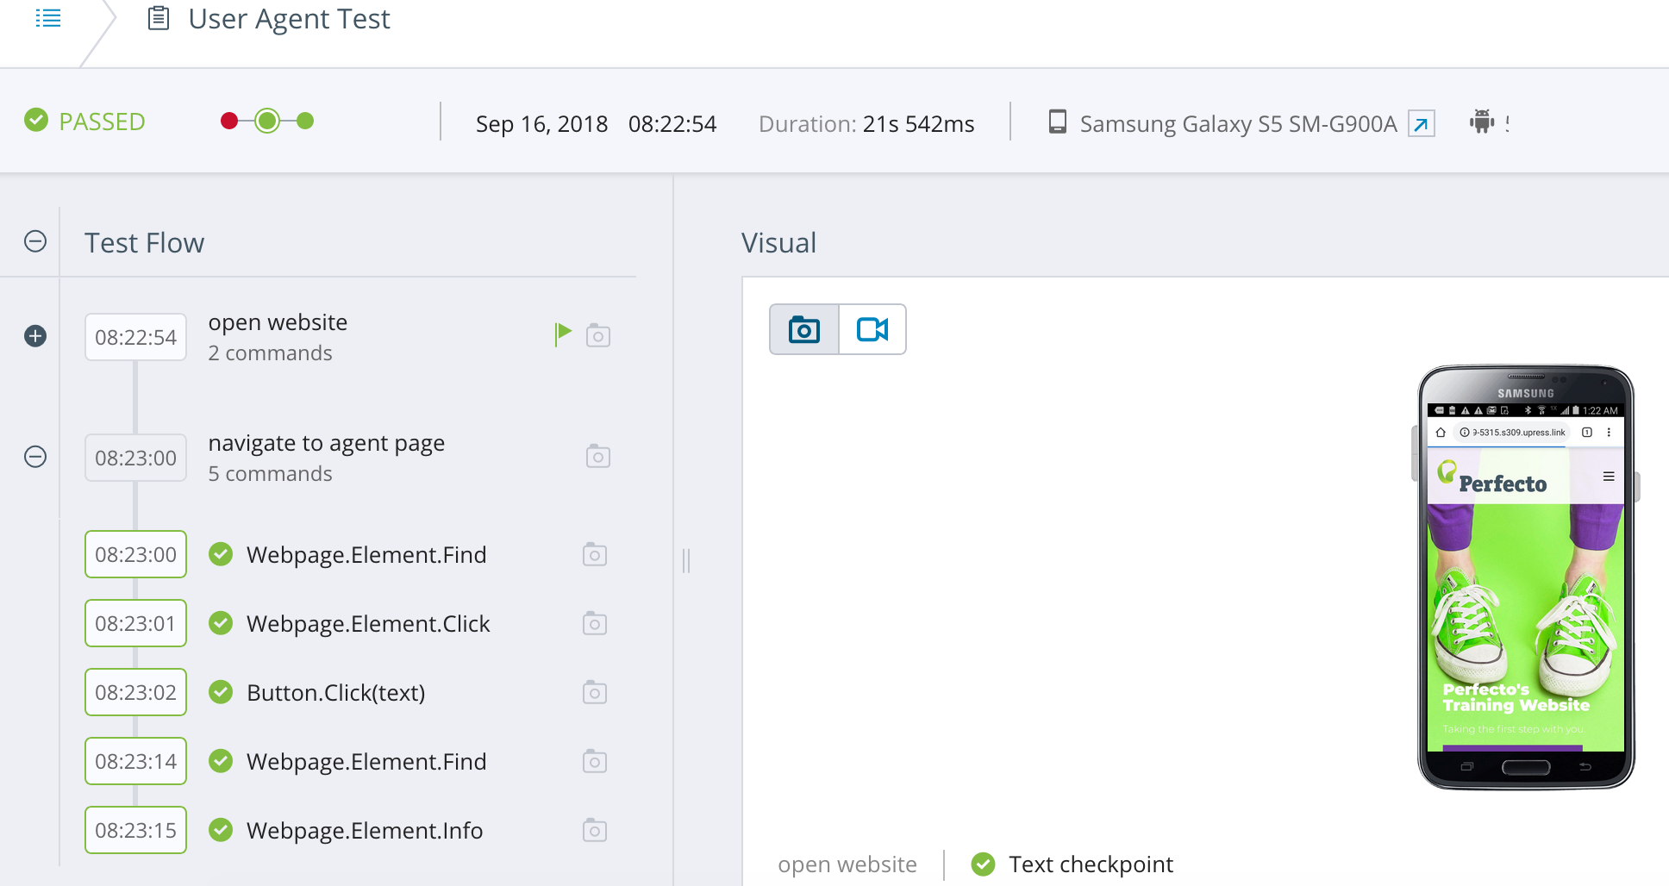
Single Test Report – Drill down for Root Cause Analysis + Artifacts
Notes:
The test reports lists all steps, contains a video & can include logs and network files if defined by the user.
Everything can be downloaded through the digitalZoom API.

Slide 12
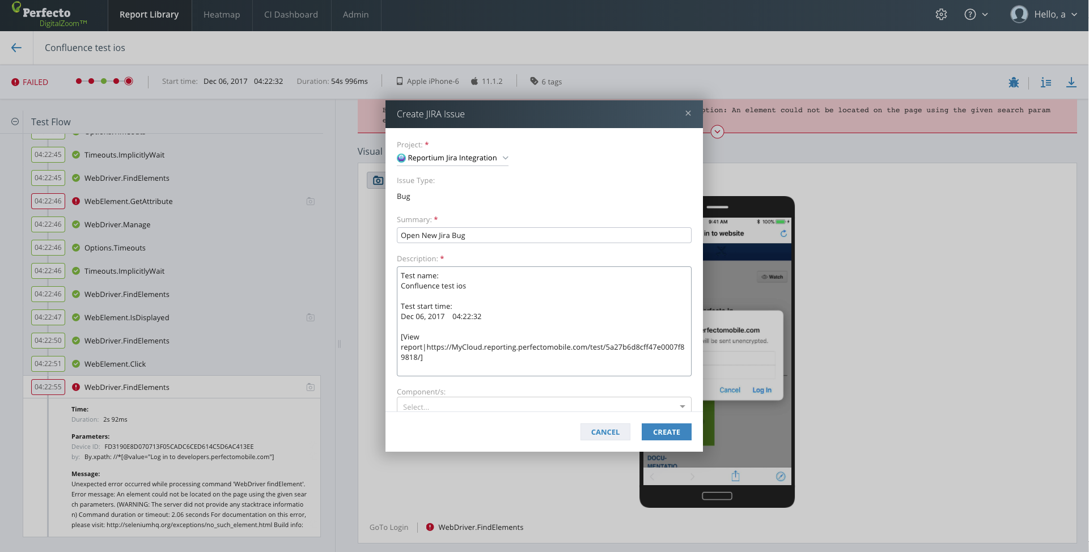
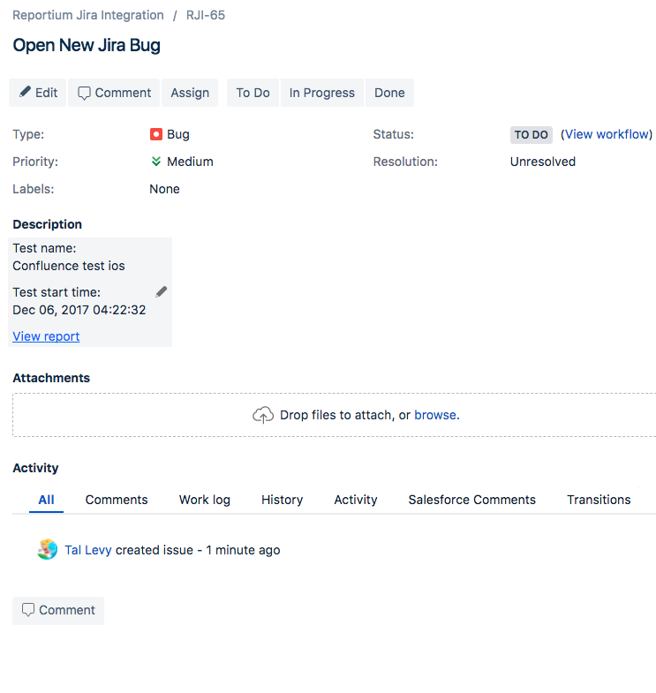
Single Test Report – Open Jira Bug directly from the Single Test Report
Notes:
Integration with Jira allows seamless interaction to open issues from within DigitalZoom.

Slide 13
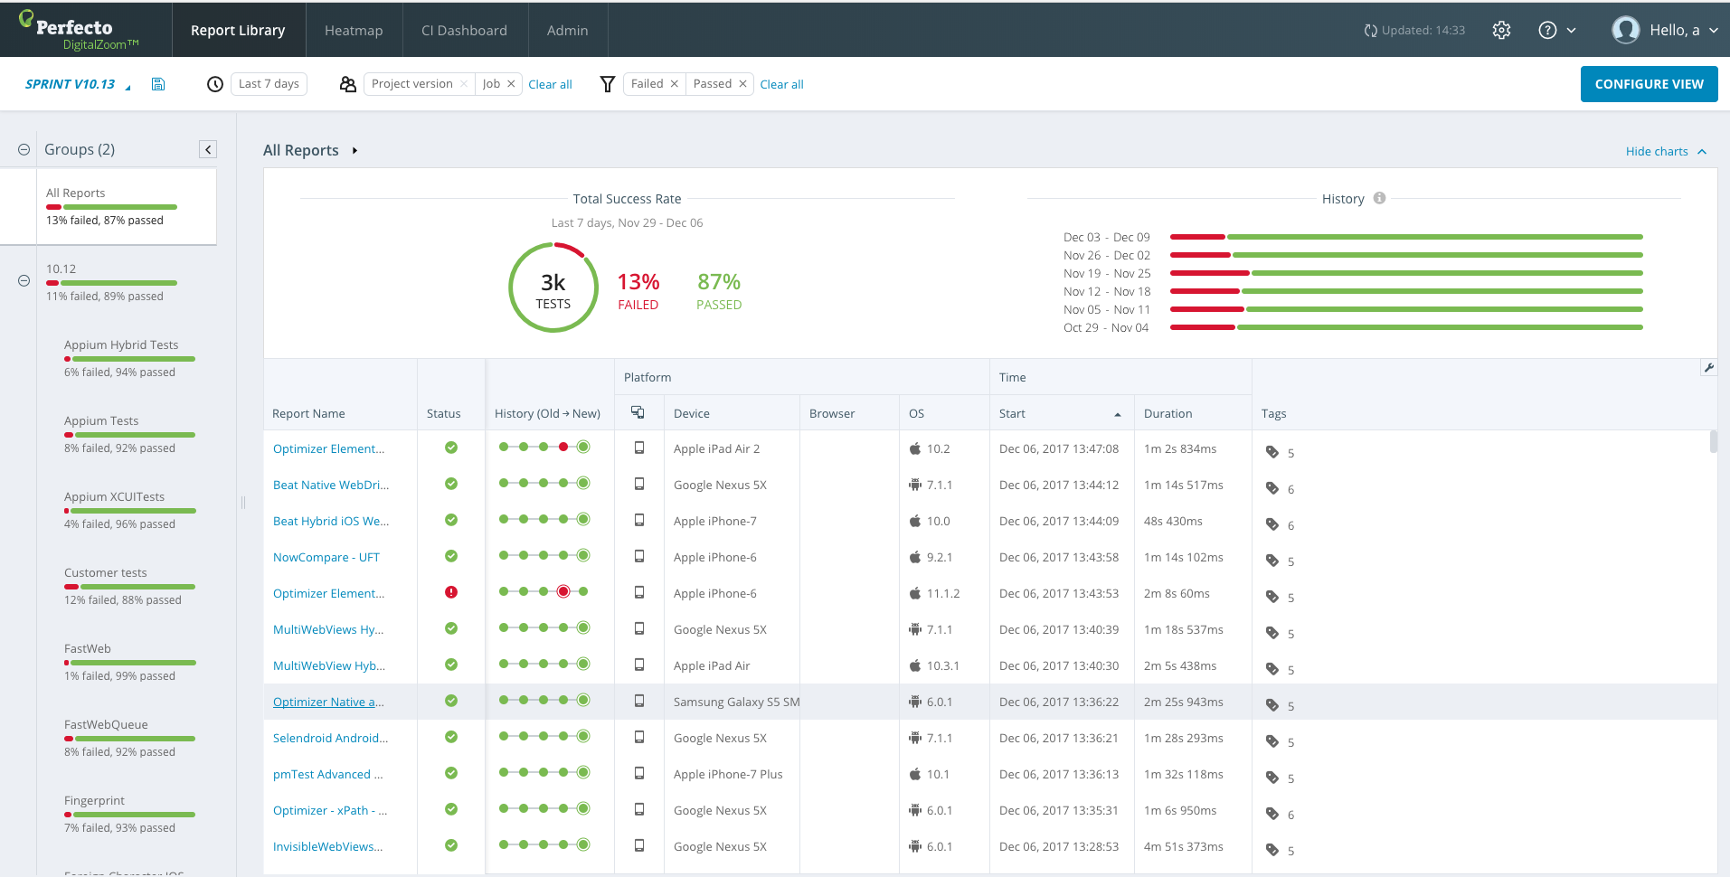
Reports Library - Testing at scale and drill down on specific quality areas
Notes:
The reports library shows a list of executions. Each execution can be opened and viewed.
The view in the library is configurable, dates, platforms, tags, devices and more can be changed to give the ideal view for what you need.
It is possible to save multiple views as well.

Slide 14
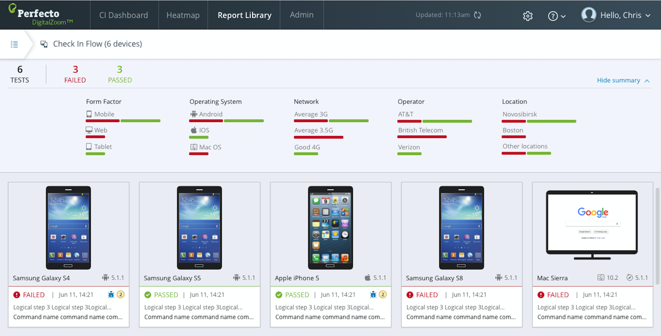
Notes:
By grouping & focusing on the criteria you are interested in you can generate custom views that tell you at a glance where problems are located.
We’ll now go into the reporting application and look at the report library in action.
Open the reporting library and create a custom view with:
Dates
Success criteria
Group by with levels
Form Factor

Slide 15
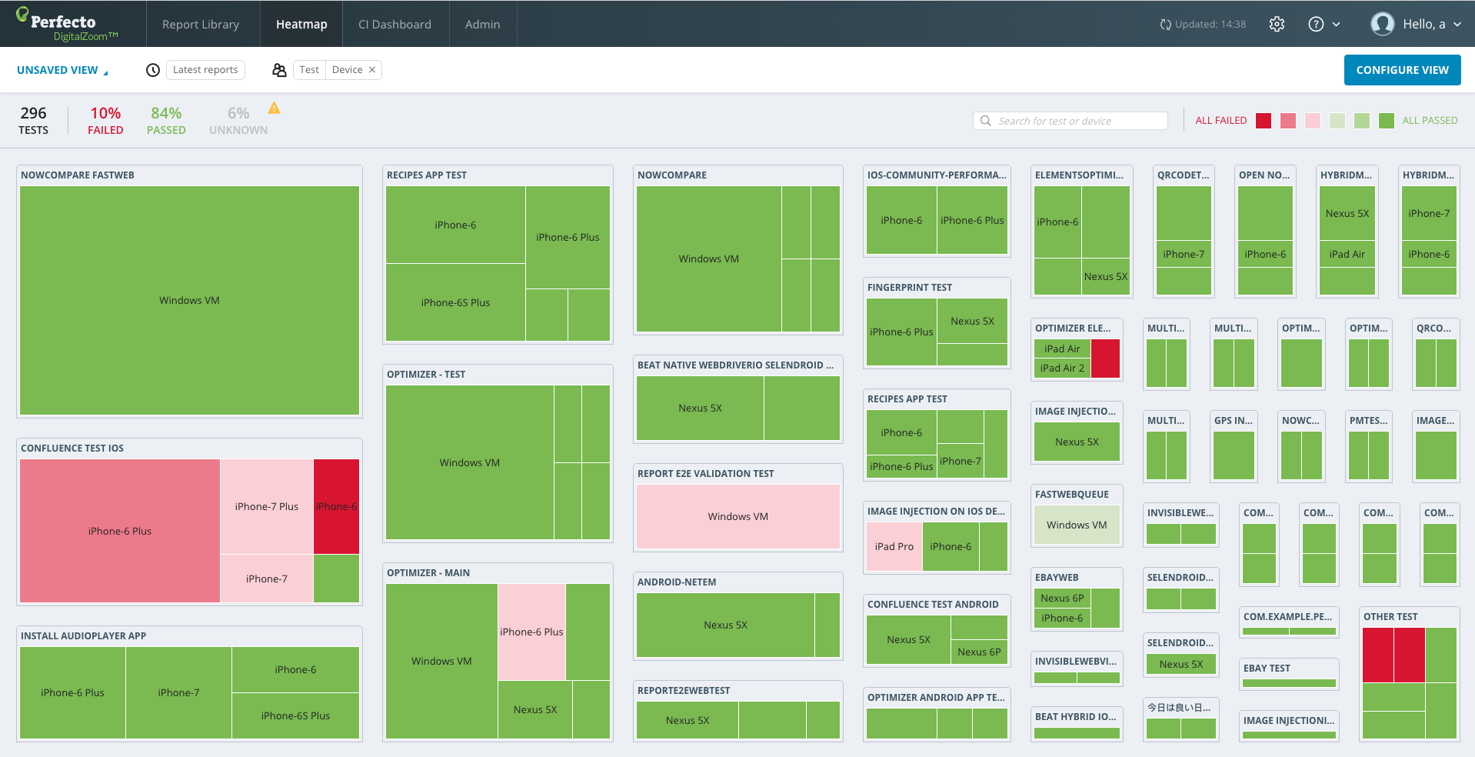
Heatmap Dashboard – Executive/team level quality assessment
Notes:
The Heatmap shows the same information in the report library i.e. executions & status, with an added element of visually slicing the data into tests & devices.
This enables an instant understanding of where the app is failing.

Slide 16
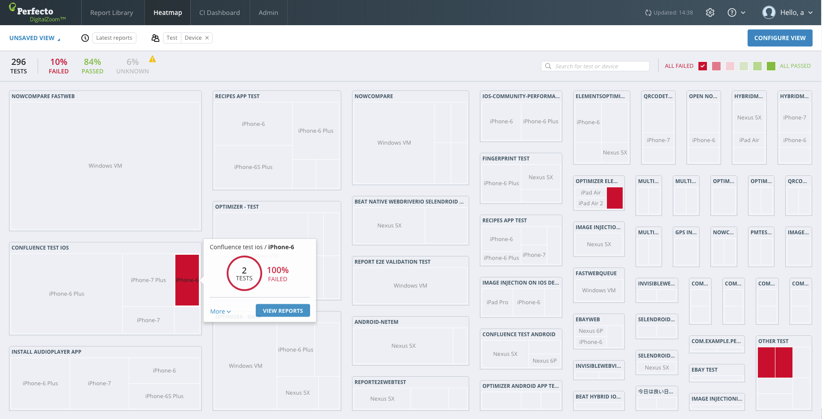
Heatmap Dashboard – filter to identify risk areas)
Notes:
Open the heatmap and display.

Slide 17
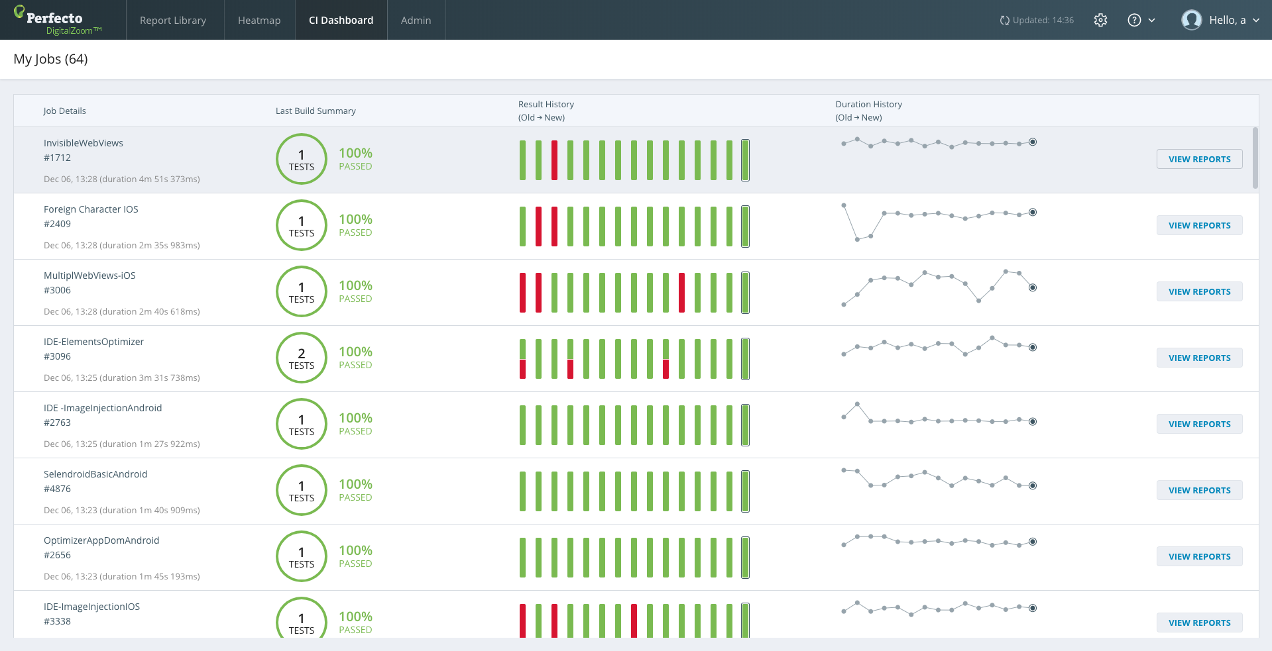
CI Dashboard – Fast feedback for Continuous Integration users: get instant build quality visibility
The CI Dashboard delivers a historical view of test suite results. The primary user of the view is management to understand overall quality trending.
Notes:
The CI dashboard is another view which looks at results per job over time.
This is a useful metric to validate specific jobs are running as expected and over time provides valuable insight over performance & quality.

Slide 18
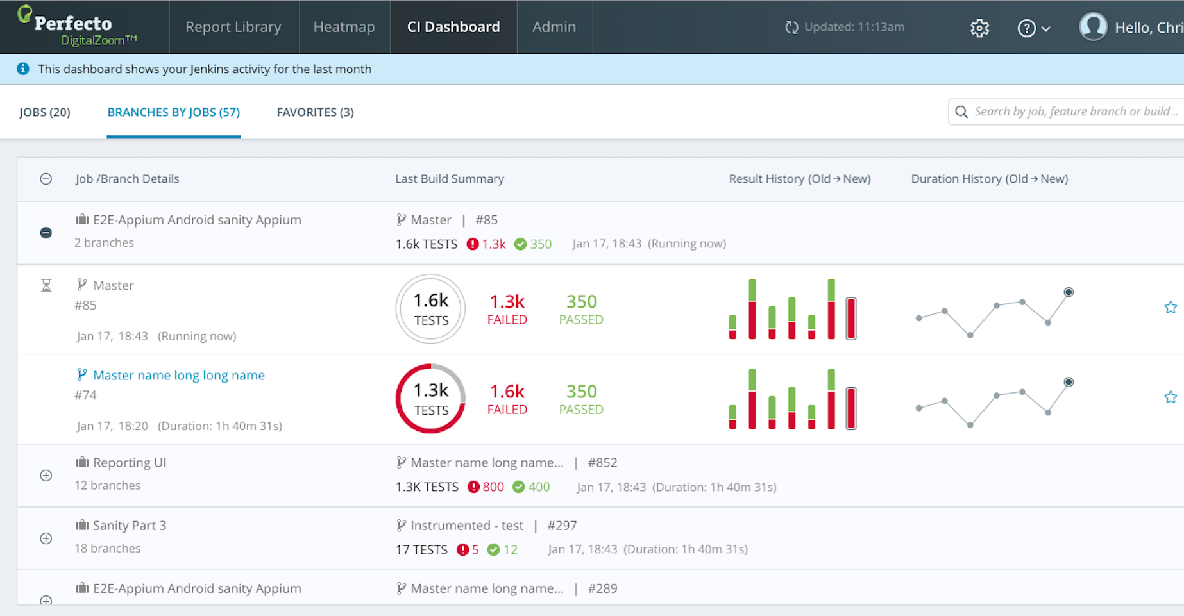
CI Dashboard – Enjoy Pipeline Quality visibility across different Feature Branches

Slide 19
Increasing Value

Slide 20
What to do inside the test?
The reportiumClient class contains all the methods needed to insert reporting data into the test.
testStart – used to indicate the name of the test and add tags for specific test run.
stepStart – start of a logical step in the test, provide a name for the step.
stepEnd – ends the current logical step.
testStop – ends the test, provide a finishing status (see below).
reportiumAssert – declare a condition for the DigitalZoom analysis to evaluate.
As part of the testStop() call, supply the status of how the test completed.
Use the TestResultFactory class to generate the status:
createSuccess – used to indicate the test completed without problem.
createFailure – used to indicate a failed test, include an optional message, and characterize using a failure reason.
Notes:
Open your IDE and show the different methods in the sample.

Slide 21
How to define the tests
The DigitalZoom system displays many different views of the test reports.
The different views can also filter or group the test reports based on information supplied by the test code to help associate the test run with different parameters.
At different levels you can define the following types of information:
  CI Job information – Job Name, Job Number, Project
  Tags – for each Project, each Test, based on how Test finishes (in testStop).
  Custom fields - <key, value> pairs that provide additional identification info.
  Completion status – failure reason, completion message
Notes:
We have seen how Digital zoom can show many kind of levels at once. We will know see how your code needs to written to provide the information at run time for future use.

Slide 22
Job Level
Required for the CI Dashboard view
An execution context is created
Job name should match the name in Jenkins (or other CI tool)
  One Job may contain multiple tests so the tags should fit what is relevant for all tests.
  Individual tests can add tags, but not remove.
PerfectoExecutionContext perfectoExecutionContext = new PerfectoExecutionContext.PerfectoExecutionContextBuilder()
.withProject(new Project("C# Training", "1.0"))
.withJob(new Job("My Job", 45))
.withContextTags(new[] { "imageInject", "assignment", "c#" })
.withWebDriver(driver)
.build();
reportiumClient = PerfectoClientFactory.createPerfectoReportiumClient(perfectoExecutionContext);

Slide 23
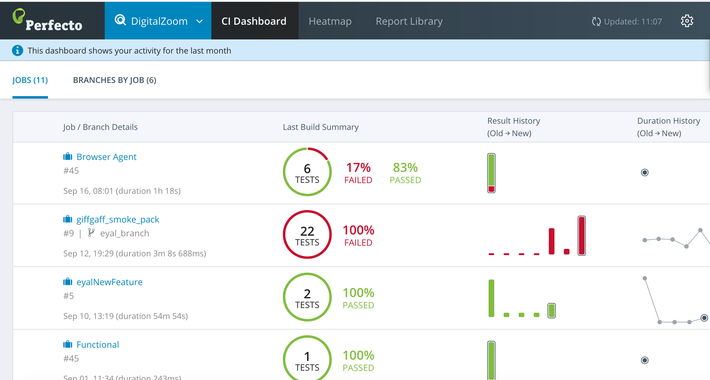
The Job Definition Creates the Dashboard

Slide 24
Test Level
We start the test in the code – with a name & tags
We divide the test into logical steps
  Each step starts with a descriptions
  All commands need to be inside steps
  A new step begins straight after one ends
reportClient.testStart("User Agent test", new TestContextTags("assignment2", "training"));
…
reportClient.stepStart("Open the website");
driver.Navigate().GoToUrl("https://training.perfecto.io");
pars.Clear();
pars.Add("content", "Training Website");
pars.Add("timeout", 20);
String res = (String)driver.ExecuteScript("mobile:checkpoint:text", pars);
if (!res.ToLower().Equals("true")) {
reportClient.reportiumAssert("homepage loaded", false); }
reportClient.stepEnd();

Slide 25
Assertions
Assertions are any specific functionality that we want to take special note of e.g. transfer funds
We can define an assertion with it’s status
A test contains multiple interactions & navigations – an assertion focuses on just one.
// test step: open a premium account
reportiumClient.stepStart(“Open a premium client”);
IWebElement premiumAccount = driver.FindElementById(“premium-account”);
if (premiumAccount.Text().ToLower().Equals(“premium")) {
reportiumClient.reportiumAssert(“Check for premium account”, true);
premiumAccount.click();
} else {
reportiumClient.reportiumAssert(“Check for premium account”, false);
}

Slide 26
Ending the Test
We can set the status of the test as pass or fail
This allows us to bypass the automatic system and set the status according to business logic
Failure status supports adding a string message of the failure
if (res.ToLower().Equals("true"))
{
reportiumClient.testStop(TestResultFactory.createSuccess());
} else {
reportiumClient.reportiumAssert("Failed to view image", false);
reportiumClient.testStop(TestResultFactory.createFailure("Failed to view image", null));
}
} catch (Exception e) {
reportiumClient.testStop(TestResultFactory.createFailure(e.Message, e));
}

Slide 27
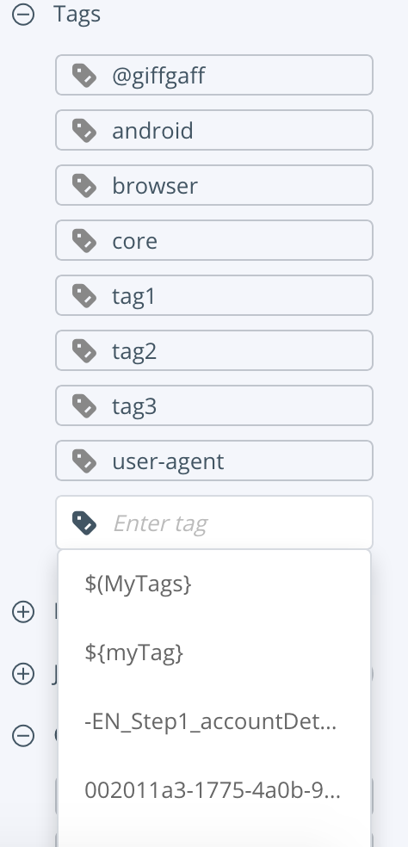
Tagging
Tags feed into the search, by tagging abundantly searching for a particular item will bring up all the relevant tests.
Tags can be shared across tests & jobs
Filters & views by tags are often the fastest way to get required info.
Important: Tags are supported on the test & Job level

Slide 28
Bringing it all together
Getting value from DigitalZoom is easy, follow these steps:
Ensure DigitalZoom is fully integrated in your code.
  DigitalZoom is a separate API that needs to be included when running tests. It is already pre-built in the templates we used and in Quantum. Users with custom frameworks must include it.
Leverage tags, test names, & steps.
  Provide each test with a name, add steps to each meaningful interaction.
  Add tags you can later use for filters to more easily identify tests.
Create views in the Report Library
Search the HeatMap & CI Dashboard for more insights into results.

Slide 29
Resources
Documentation - https://developers.perfectomobile.com/display/PD/DigitalZoom+Reporting
Jira integrations - https://developers.perfectomobile.com/display/PD/Configuration+and+Setup
Viewing Reports - https://developers.perfectomobile.com/display/PD/Viewing+the+Reports
Using the DigitalZoom SDK in your C# test - https://developers.perfectomobile.com/display/PD/C#

Slide 30
Thank You

